Slide 1
DS-306 Data Warehousing and Business Intelligence
Topic 7: ETL Designing
Dr. Khurram Shahzad
https://www.youtube.com/watch?v=0ikNnenDyNw

Slide 2
Two strategies of DW
Top down (DW to Marts)
Bottom up (Mars to DW)

Slide 3
Two strategies of DW
Top down (DW to Marts)
  Typically, separate ETL for DW and for Marts
Bottom up (Marts to DW)
  Enterprise-wide ETL is partly from data marts
  Partly from data sources

Slide 4
The ETL Solution

Slide 5
Major steps in ETL
1. Determine all the target data needed in the DW
2. Determine all the data sources, internal and external
3. Prepare data mapping for target data elements from sources
4. Establish comprehensive data extraction rules
5. Determine all the target data needed in the DW
6. Plan for aggregate tables
7. Organize data staging areas and test tools
8. Write procedures for all data loads
9. ETL for dimension tables
10. ETL for fact tables

Slide 6
ETL Modeling

Slide 7
Overview
ETL is a complex and costly task, so its important to reduce its development and maintenance cost
Modeling ETL at a conceptual level is the way forward
Tools have their own languages
  Pehntaho Data Integration (Keetle) has a language
  Microsoft Integration Service has a language

Slide 8
Overview
ETL is a combination of control and data tasks
Controls which represent the orchestration of an ETL process
Data tasks define what actions need to be performed on data
  Actions are, extraction, transformation, loading

Slide 9
BPMN
Business Process Modeling Notation (BPMN)
A de facto standard for specifying business processes
A graphical notation for defining and understanding processes
BPMN provides a conceptual and implementation-independent specification of processes
Hides technical details and allows designers

Slide 10
BPMN
‘A business process is a collection of related activities or tasks in an organization whose goal is to produce a service or product’
Task can be performed by software, human or both
BPMN released by OMG

Slide 11
BPMN elements
Four basic categories of elements
  Flow objects: Have three types
      Activities
      Gateways
      And, Events
  Connecting objects
  Swimlanes, and
  Artifacts

Slide 12
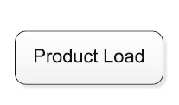
1. Flow Objects: Activities
Activity

Slide 13
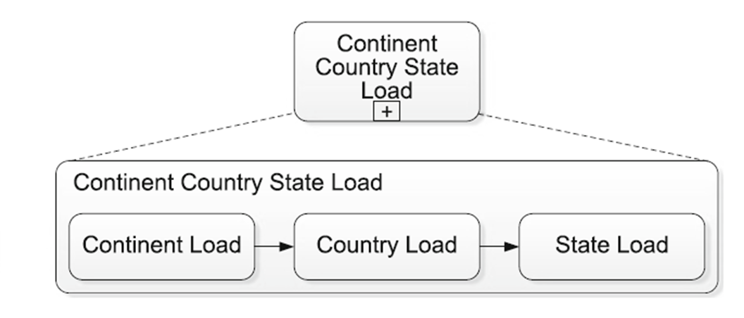
1. Flow Objects: Subprocess
Sub-process (collapsed and expanded)

Slide 14
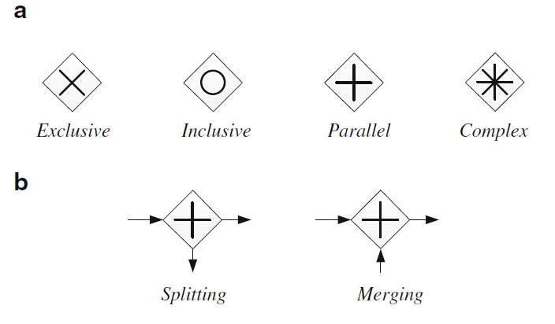
1. Flow Objects: Gateways
Gateways are used to control sequence of activities

Slide 15
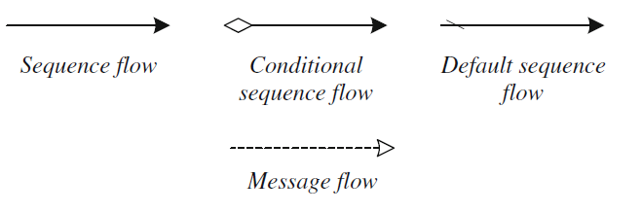
2. Connecting objects
Used to represent how objects are connected

Slide 16
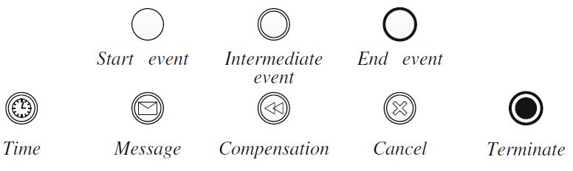
3. Events
Represents something that happens that can affect sequence of timing of the workflow activities

Slide 17
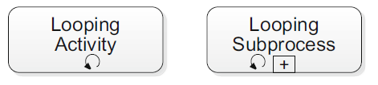
Flow Objects: Activities loops

Slide 18
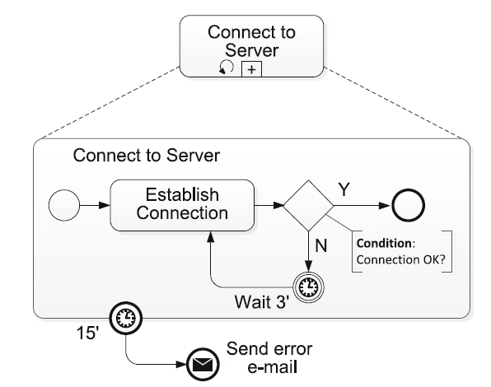
Flow Objects: Activities loops

Slide 19
3. Swimlanes
Swimlanes are used to organized ETL process according to strategies
  Technical Architectures (such as servers)
  Business Entities (such as departments)
  And Occasionally
  User profiles (such as managers, analysts)

Slide 20
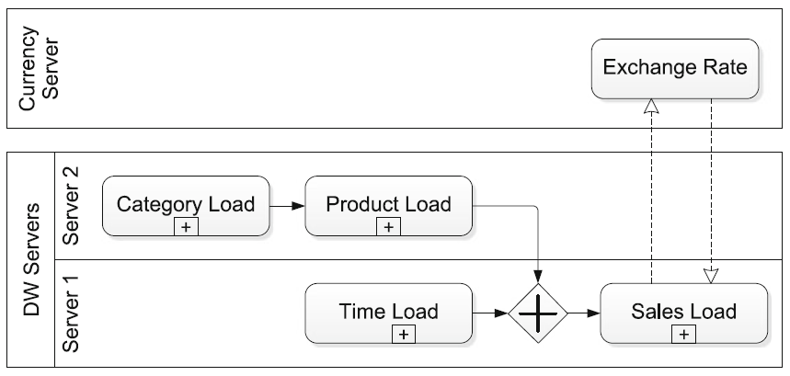
3. Swimlane
A structuring object that comprises pools and lanes

Slide 21
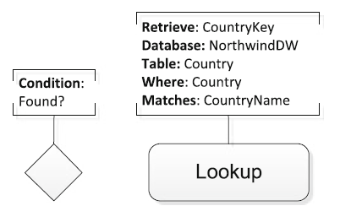
4. Artifacts
Artifacts are used to add information to diagram
  Data object, grouping of tasks, annotations

Slide 22
Conceptual ETL design using BPMN

Slide 23
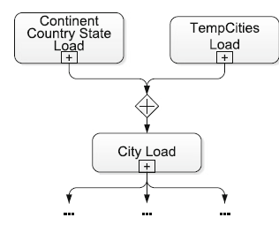
ETL Design using BPMN

Slide 24
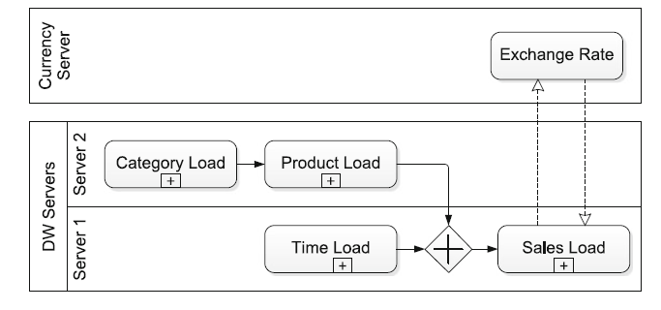
ETL Design using BPMN
Swimlanes example with architecture

Slide 25
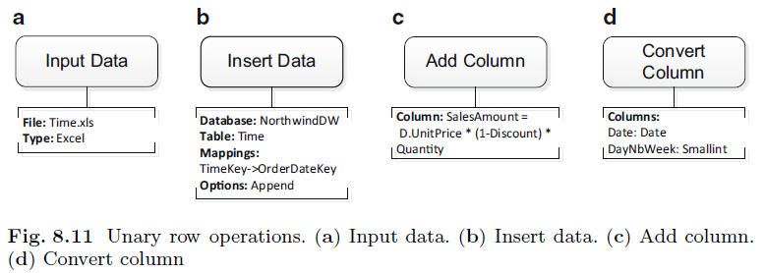
ETL Design using BPMN
Data tasks represent activities typically carried out to manipulate additive measure

Slide 26
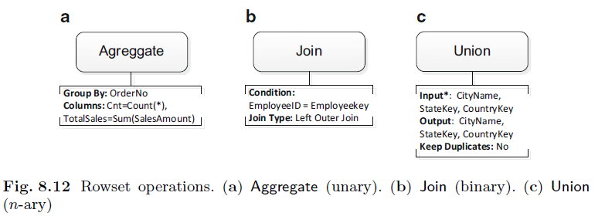
ETL Design using BPMN
Rowset operations

Slide 27
NorthWind case study

Slide 28
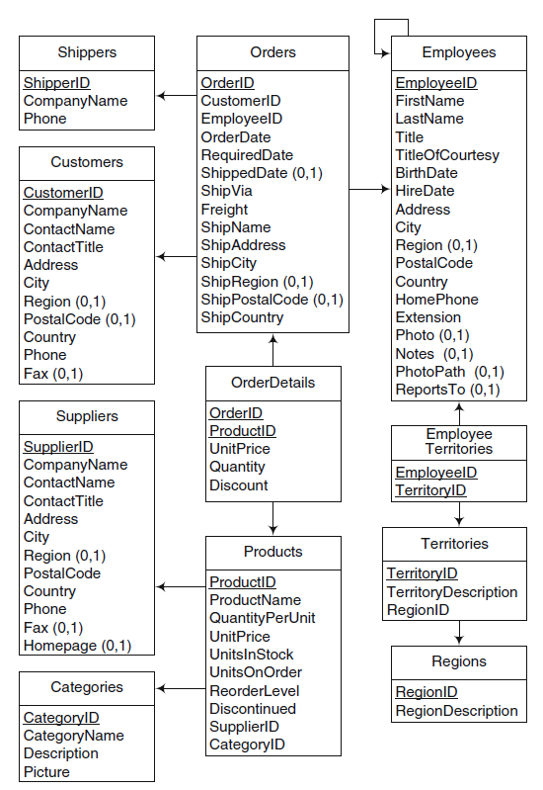

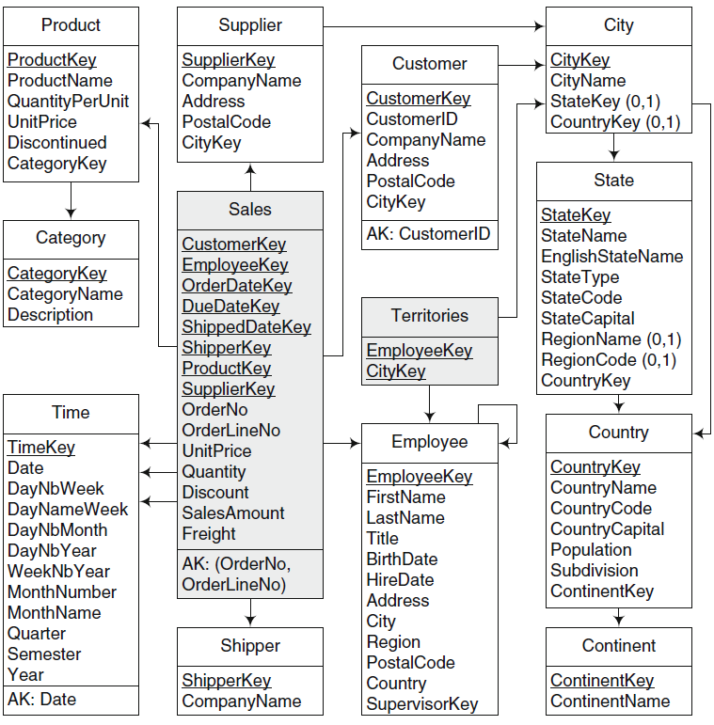
1
5
2
4
3
2
3
4
5
1

Slide 29
Conceptual Design for NorthWind
In addition to operational database, some other files are needed for loading DW
  Supplier, customer geographic hierarchy City -> State -> Country -> Continent

Slide 30
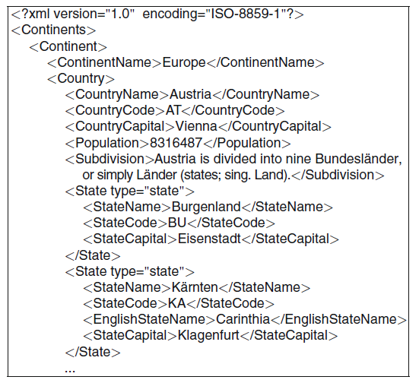
XML schema Territories

Slide 31
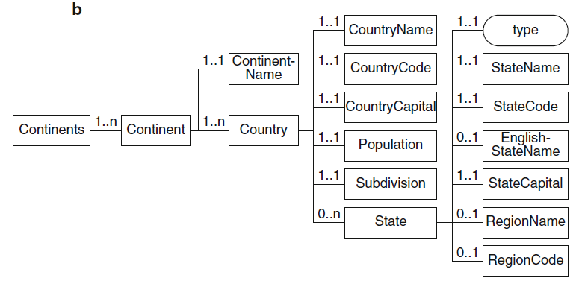
XML schema of the file

Slide 32
Fact Table
Sales
CustomerKey
EmployeeKey
OrderDateKey
Duedatekey
Shippeddatekey
Shipperkey
OrderNo
OrderLine No
UnitPrice
Quantity
Discount
SalesAmount
Freight

Slide 33
Fact Table
Sales
CustomerKey
EmployeeKey
OrderDateKey
Duedatekey
Shippeddatekey
Shipperkey
OrderNo
OrderLine No
UnitPrice
Quantity
Discount
SalesAmount
Freight
Sales amount is calculated using
  Unit price, discount and quantity

Slide 34
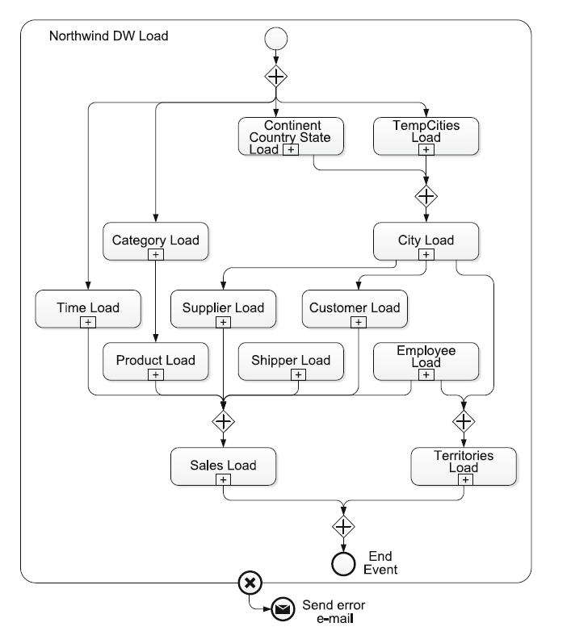
ETL
Overall

Slide 35
Two level ETL modeling
Overall ETL
  Process, composed of subprocesses
Table level
  Subprocesses composed of activities or further subprocesses

Slide 36
Subprocess
Sales Load

Slide 37
Create sub-process of Sales fact
Sales
CustomerKey
EmployeeKey
OrderDateKey
Duedatekey
Shippeddatekey
Shipperkey
OrderNo
OrderLine No
UnitPrice
Quantity
Discount
SalesAmount
Freight

Slide 38
Job scheduling
The scheduler jobs can be made time or event dependent or file dependent
  Example, start the job at 3 AM
  Wait for a particular file to be available and trigger the first file
Support teams usually monitor the job runs
  Teams can see
    If the flow is running fine
    If a job has failed
    Reason for failure
    What job is waiting, etc.

Slide 39
Error Handling
  After scheduling of job comes monitoring
  There are two parts of monitoring
    What to do to get the job back up so that the flow can resume?
    Log the error in the table
  For staging job and dimension jobs ETL tool can be configured to run again on failure
  For minor error these can be set and job can be re-run
  If it fails again, support team will look at it

Slide 40
Error Handling
  Audit table form an important part of the ETL process
  One design approach would be to create groups, dimension group, fact group
  At the end of completion of all the jobs in the group, another job makes an entry saying that group has completed
  Apart from audit tables, ETL tools have their own logs to debug errors

